Slide 1

SI100B Introduction to Information Science and Technology (Python Programming)
高盛华
School of Information Science and Technology
ShanghaiTech University
Slides credited to Prof Haipeng Zhang

Slide 2
Learning Objectives
Classes and objects
Instance variables
Class variables
Instance methods
Class methods
Access
Private and public attributes
Special method names
Inheritance

Slide 3
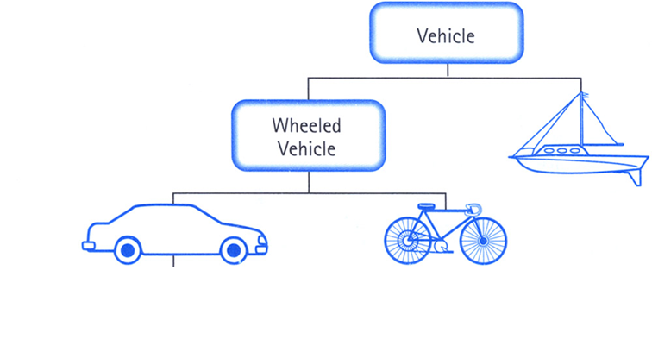

Classes
Car Class
Car Objects

Slide 4
Object‐Oriented Programming
In OOP, code and data are combined into a single entity called a class
each instance of a given class is an object of that class type
a class is like an object constructor, or a "blueprint" for creating objects.
Principles of Object­‐Oriented Programming
Encapsulation
hides the implementation details of a class from other objects
Inheritance
form new classes using classes that have already been defined, and keep some characteristics
Polymorphism
using an operator or function in different ways for different data input
Python is object-oriented
Everything in Python is an object (excluding keywords)

Slide 5
Class Definition
“class” ClassName”:”
<statement-1>
.
.
<statement-N>
INDENT
A class definition starts with the keyword class
The first character of the class name is usually UPPERCASED
Then, the colon :
The class body consists of a sequence of statements and/or function definitions, organized via INDENT

Slide 6
The Smallest Class
Comment for docstring
Class Demo definition
INDENT

Slide 7
The Smallest Class
Output
1
2
<class 'type'>
<class '__main__.Demo'>
Four statements are executed when entering class Demo
Demo is an object/instance of the class type
The object Demo is in the global scope called __main__

Slide 8
Instance objects
Class instantiation uses function notation:
Obj = ClassName(parameters)
Create an instance object of Demo
Output
<class 'type'>
<class '__main__.Demo'>
<__main__.Demo object at 0x02CA8490>
<class '__main__.Demo'>
2
1

Slide 9
Instance objects
We can check whether an object is an instance of a class
isinstance(object, class)
Output
Yes
Yes
Demo is a class object vs d is an instance object

Slide 10
Constructor __init__
All the classes have an implicit instance method __init__ as constructor (inherited from the class object)
The __init__() function is called automatically every time the class is being used to create a new instance object
It is called after the instance has been created, but before it is returned to the caller
The arguments are those passed to the class constructor expression
The first parameter of __init__ is the instance object
One can override __init__ in user-defined classes for initialization
Notes:
override 重写

Slide 11
Constructor __init__
Create a class named Person, use the __init__() function to assign values for name and age:
class Person: def __init__(self, name, age): self.name = name self.age = age p1 = Person("John", 36) print(p1.name) print(p1.age)
Output
John 36

Slide 12
self Parameter
The first parameter of all instance methods is bound to the instance object
The name of the first parameter can be any identifier
But, we usually use self

Slide 13
self Parameter
They are same

Slide 14
Attributes
Attributes of an instance
instance variables: are for data unique to each instance
instance methods: are for manipulation of instance data
Attributes of a class
class variables: are for data shared by all instances of the class
class methods: are for manipulation of class data
All can be dynamically added/removed in Python
It is better to use different names for class attributes and instance attributes
Notes:
属性
实例变量，实例方法
类变量，类方法

Slide 15
Instance variables
All variables defined via
obj.var = expr
are instance variables var of the object obj
value is an instance variable of the object bound to the name self

Slide 16
Instance variables
Instance variables are dynamically added into objects
Output
Red QQ
Blue BYD
>>>

Slide 17
Instance variables
Added instance variable is specific to the object
Output
Red QQ
Traceback (most recent call last):
File "D:\Test\fib.py", line 9, in <module>
print(car2.color,car2.name)
AttributeError: 'Car' object has no attribute 'name'

Slide 18
Instance variables
An instance variable is deleted from the object
Output
Red QQ
Traceback (most recent call last):
…..
AttributeError: 'Car' object has no attribute 'color'

Slide 19
Instance variables
It is recommended to initialize all the instance variables in the constructor __init__

Slide 20
Class variables
All variables defined via
var = expr
in the class definition are class variables of the class object, shared by all its instances.
classvariable
classvariable

Slide 21
Class variables
All variables defined via
var = expr
in the class definition are class variables of the class object, shared by all its instances.
instancevariable
classvariable

Slide 22
Class variables
Defined in different places
A class variable is dynamically added
Output
classvariable
classvariable2
AddValue
>>>

Slide 23
Class variables
A class variable is dynamically deleted
classvariable
Traceback (most recent call last):
….
AttributeError: type object 'A' has no attribute 'value'
Output

Slide 24
Class variables
It is recommended to initialize all the class variables at the beginning of the class definition

Slide 25
Learning Objectives
Classes and objects
Instance variables
Class variables
Instance methods
Class methods
Access
Private and public attributes
Special method names
Inheritance

Slide 26
Instance methods
The first parameter of instance methods are the instance object, i.e., self (you may use other names)
__init__ and GetValue are instance methods

Slide 27
Instance methods
SetValue is a normal function, not an instance method
a.SetValue is an instance variable, not an instance method
Called with the object as first argument
Output
<function SetValue at 0x03032150>
>>>

Slide 28
Instance methods
import module types
Dynamically add SetValue as an instance method of the object a
Direct call SetValue via the object a
Output
<bound method SetValue of <__main__.A object at 0x02FE8470>>

Slide 29
Instance methods
An instance method is dynamically deleted
<bound method GetValue of <__main__.A object at 0x035984F0>>
Traceback (most recent call last):
…..
AttributeError: 'A' object has no attribute ‘GetValue'
Output

Slide 30
Instance methods
It is recommended to define all the instance methods in class definition

Slide 31
Learning Objectives
Classes and objects
Instance variables
Class variables
Instance methods
Class methods
Access
Private and public attributes
Special method names
Inheritance

Slide 32
Class methods
The first parameter of class methods is the class object, i.e., cls
@classmethod is a Decorator claiming that the function defined following this is a class method
Output
<bound method A.GetClassValue of <class '__main__.A'>>

Slide 33
cls Parameter
The first parameter of all class methods is bound to the class object
The name of the first parameter can be any identifier
But, we usually use cls

Slide 34
Class methods
Dynamically add SetClassValue as a class method of the class A
Output
<bound method SetClassValue of <class '__main__.A'>>

Slide 35
Class methods
GetClassValue of the class A
is deleted
<bound method A.GetClassValue of <class '__main__.A'>>
Traceback (most recent call last):
…
AttributeError: type object 'A' has no attribute 'GetClassValue'
Output

Slide 36
Learning Objectives
Classes and objects
Instance variables
Class variables
Instance methods
Class methods
Access
Private and public attributes
Special method names
Inheritance

Slide 37
Access
Instance variables: are accessed via
object.var
Instance methods: are accessed via
object.f(p₁,…,p_{n})
Class variables: are accessed via
class.var
Class methods: are accessed via
class.f(p₁,…,p_{n})
It is better to use these forms

Slide 38
Access
Instance variables: are accessed via
object.var
Instance methods: are accessed via
object.f(p₁,…,p_{n}) or class.f(object,p₁,…,p_{n})
Class variables: are accessed via
class.var or object.var
Class methods: are accessed via
class.f(p₁,…,p_{n}) or object.f(p₁,…,p_{n})
Assuming all attributes are distinct

Slide 39
Access Instance attributes
Output
Red
Red
Red
Traceback (most recent call last):
….
print(Car.color)
AttributeError: type object 'Car' has no attribute 'color'

Slide 40
Access Class attributes
Output
Blue
Blue
Blue
Blue
Traceback (most recent call last):
…
print(GetColor(Car))
NameError: name 'GetColor' is not defined

Slide 41
Learning Objectives
Classes and objects
Instance variables
Class variables
Instance methods
Class methods
Access
Private and public attributes
Special method names
Inheritance

Slide 42
Private and Public Attributes
Python uses underscore to define special attributes
_xxx: denotes protected attribute xxx which cannot be imported using ‘from module import *’
__xxx__: system defined attribute xxx, e.g., __init__
__xxx: private attribute xxx, which should be accessed via instance methods, cannot be accessed via object.__xxx outside of the class, or instance methods of its subclasses (we can still access via “object._class__xxx”)

Slide 43
Private and Public Attributes
__init__: special name method
__color: intended to be private instance attribute
__color: can be accessed in instance methods
AttributeError
Output
Red
Red
Traceback (most recent call last):
AttributeError: 'Car' object has no attribute ‘__color'

Slide 44
Private and Public Attributes
__color and __GetColor: intended to be private attribute
AttributeError
Traceback (most recent call last):
File "C:\Users\Desktop\hello.py", line 8, in <module>
print(car.__GetColor())
AttributeError: 'Car' object has no attribute ‘__GetColor'
Output

Slide 45
Private and Public Attributes
__color and __GetColor: intended to be private attribute
can be accessed via special way
Output
Red
Red
>>>

Slide 46
Private and Public Attributes
__color: intended to be private class attribute
__color: can be accessed in this class
AttributeError
Output
Blue
Traceback (most recent call last):
…
AttributeError: type object 'Car' has no attribute '__color'

Slide 47
Private and Public Attributes
__GetColor: intended to be private class attribute
AttributeError
Traceback (most recent call last):
File "C:\Users\Desktop\hello.py", line 7, in <module>
print(Car.__GetColor())
AttributeError: type object 'Car' has no attribute ‘__GetColor'
Output

Slide 48
Private and Public Attributes
can be accessed via special way
Blue
Blue
<<<
Output

Slide 49
Learning Objectives
Classes and objects
Instance variables
Class variables
Instance methods
Class methods
Access
Private and public attributes
Special method names
Inheritance

Slide 50
Constructor and Destructor
Creator __new__(cls,…): is called to create a new instance of class cls, e.g.,
obj=cls(p₁,…,p_{n})
__new__ takes the class of which an instance was requested as its first argument. The other arguments are those passed to __init__(self,…)
__new__ returns the new object instance before __init__ is invoked
Constructor __init__(self,…): is called after the instance has been created to initialize instance variables
Destructor __del__(self): is called when the instance is about to be destroyed, the object is destroyed when the reference count of the object reaches zero
Notes:
构造函数
析构函数

Slide 51
Example

Slide 52
Example

Slide 53
Example
Output
Balance of 1 is: 10
Balance of 2 is: 20
Balance of 3 is: 30
Number of accounts is: 3
Number of accounts is: 2
Number of accounts is: 1

Slide 54
Common special method names
Method | Description
__new__() | Create a new object instance
__init__() | Constructor
__del__() | Destructor
__add__() | +
__sub__() | -
__mul__() | *
__truediv__() | /
__floordiv__() | //
__mod__() | %
__pow__() | **
__eq__()、 __ne__()、__lt__()、 __le__()、__gt__()、 __ge__() | ==、 !=、<、 <=、>、 >=
__lshift__()、__rshift__() | <<、>>
__and__()、__or__()、__invert__()、__xor__() | &、|、~、^
__str__() | string representation of an object

Slide 55
Example
Implement a class for rational number
Support
‘+’, ‘-’ ,’*’, ‘/’ ,’pow’,....,
Does not support
‘and’, ‘or’,....

Slide 56
Example
Euclidean Algorithm: gcd(a,b) = gcd(b,a%b)
Notes:
欧几里德算法,辗转相除法
有理数

Slide 57
Example
It is better to assign non-supported methods by None

Slide 58
Example

Slide 59
Example
Output
1/2
1/4
3/4
Traceback (most recent call last):
…
TypeError: unsupported operand type(s) for &: 'Rational' and 'Rational'

Slide 60
Learning Objectives
Classes and objects
Instance variables
Class variables
Instance methods
Class methods
Access
Private and public attributes
Special method names
Inheritance

Slide 61
Class revisit
“class” ClassName”:”
<statement-1>
.
.
<statement-N>
Class object vs instance object
Class attribute vs instance attribute
Private attribute vs public attribute

Slide 62
Inheritance
Inheritance is yet another way to reuse code
Other ways:
Functions
Classes
Modules

Slide 63
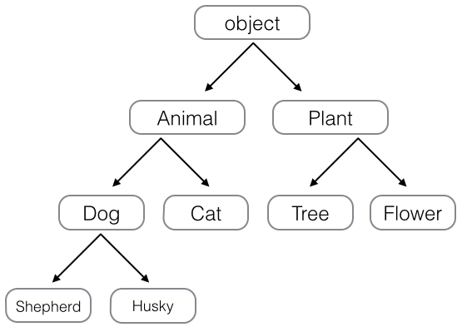
Inheritance

Slide 64
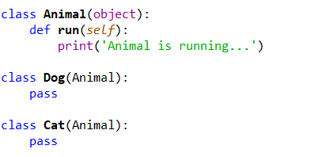
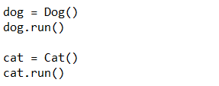
Inheritance
Output
Animal is running...
Animal is running...

Slide 65
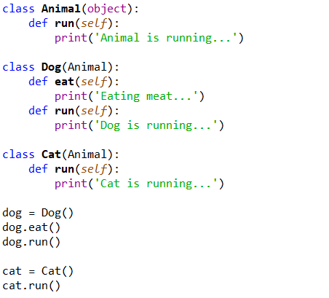
Inheritance
Output
Eating meat...
Dog is running...
Cat is running...

Slide 66
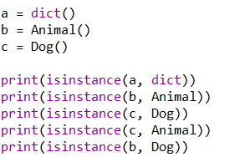
Inheritance
Output
True
True
True
True
False

Slide 67
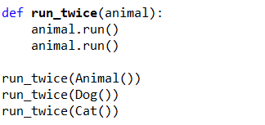
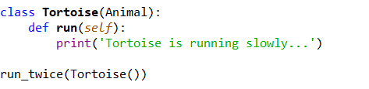
Inheritance (polymorphism)
Output
Animal is running...
Animal is running...
Dog is running...
Dog is running...
Cat is running...
Cat is running...
Output
Tortoise is running slowly...
Tortoise is running slowly...

Slide 68
Inheritance
“class” SubClass “(” BaseClass “)” ”:”
<statement-1>
.
.
<statement-N>
SubClass is meant to be more specialized than BaseClass
– adding new attributes (variables and methods)
SubClass inherits some attributes of BaseClass
SubClass can override inherited methods

Slide 69
Inheritance
Sub class inherits all public class attributes of the Base class,
But, does not inherit any private class attributes of Base classes

Slide 70
class SubClass(BaseClass):
y = "SubClass Y"
@classmethod
def __private(cls):
print(“Method-1")
@classmethod
def public(cls):
cls.__private()
BaseClass.public()
print(cls.__x)
print(SubClass.x)
print(SubClass.y)
SubClass.public()
class BaseClass:
x = "BaseClass X"
y = "BaseClass Y"
__x = "Private X"
@classmethod
def __private(cls):
print(“Method-2")
@classmethod
def public(cls):
print(“Method-3")
BaseClass X # inherited
SubClass Y # overridden
Method-1
Method-3 # call in base AttributeError # private

Slide 71
Inheritance
Sub class inherits all public class attributes of the Base class,
But, does not inherit any private class attributes of Base classes
Sub class inherits all public instance methods of the Base class
But, sub class inherits all public instance variables of the Base class, only if one of the following condition holds
The sub class does not override __init__ method of the base class, (meaning __init__ of the base class is implicitly invoked)
The sub class explicitly invokes __init__ method of the base class in its own __init__ method

Slide 72
class BaseClass:
def __init__(self):
self.x = "BaseClass X"
self.y = "BaseClass Y"
self.__x = "Private X"
def __private(self):
print("Method-2")
def public(self):
print("Method-3")
class SubClass(BaseClass):
def __private(self):
print("Method-1")
def public(self):
self.__private()
BaseClass.public(self)
print(self.__x)
s = SubClass()
print(s.x)
print(s.y)
s.public()
BaseClass X # inherited
BaseClass Y # inherited
Method-1
Method-3
AttributeError

Slide 73
class BaseClass:
def __init__(self):
self.x = "BaseClass X"
class SubClass(BaseClass):
def __init__(self):
self.z = "Subclass Z"
BaseClass.__init__(self)
s = SubClass()
print(s.z)
print(s.x)
Subclass Z
BaseClass X

Slide 74
class BaseClass:
def __init__(self):
self.x = "BaseClass X"
class SubClass(BaseClass):
def __init__(self):
self.z = "Subclass Z"
s = SubClass()
print(s.z)
print(s.x)
Subclass Z
AttributeError: 'SubClass' object has no attribute 'x'

Slide 75
Inheritance
Sub class inherits all public class attributes of the Base class,
But, does not inherit any private class attributes of Base classes
Sub class inherit all public instance methods of the Base class
But, sub class inherit all public instance variables of the Base class, only if one of the following condition holds
The sub class does not override __init__ method of the base class, (meaning __init__ of the base class is implicitly invoked)
The sub class explicitly invokes __init__ method of the base class in its own __init__ method
New/overridden method cannot access private attributes of the base class
But, inherited methods can access private attributes of the base class

Slide 76
class BaseClass:
def __init__(self):
self.__x = "Private X“
def __private(self):
print("Private 1")
print(self.__x)
class SubClass(BaseClass):
def __private(self):
print("Private 2")
def public(self):
self.__private()
print(self.__x)
s = SubClass()
s.public()
Private 2
AttributeError: 'SubClass' object has no attribute '_SubClass__x
New/overridden method cannot access private attributes of the base class

Slide 77
class BaseClass:
def __init__(self):
self.__x = "Private X"
def __private(self):
print("Private 1")
print(self.__x)
def public(self):
self.__private()
print(self.__x)
class SubClass(BaseClass):
def __private(self):
print("Private 2")
s = SubClass()
s.public()
Private 1
Private X
Private X
inherited methods can access private attributes of the base class

Slide 78
class BaseClass:
def __init__(self):
self.__x = "Private X“
def private(self):
print("Private 1")
print(self.__x)
def public(self):
self.private()
print(self.__x)
class SubClass(BaseClass):
def private(self):
print("Private 2")
s = SubClass()
s.public()
Private 2
Private X
inherited methods will first search in sub class

Slide 79
Readings (recommended)
The Python Tutorial
9. Classes

Slide 80
Recap
Classes and objects
Instance methods
Class methods
Access
Private and public attributes
Special method names
Inheritance

